Slide 1
London’s “1665” Plague Epidemic
Mortality in the First 14 Weeks of 1666

Slide 2
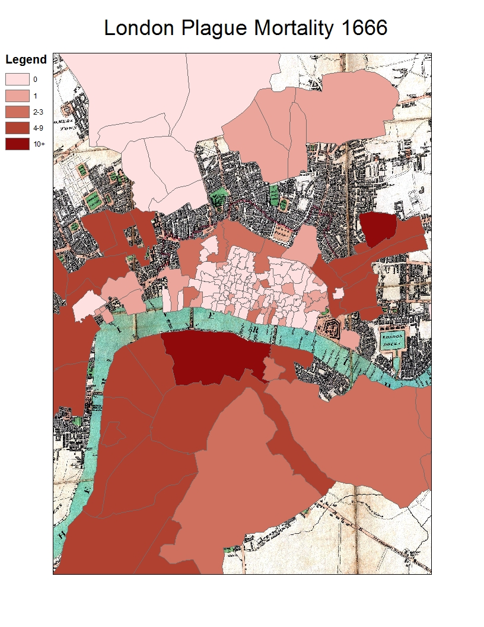

Slide 3
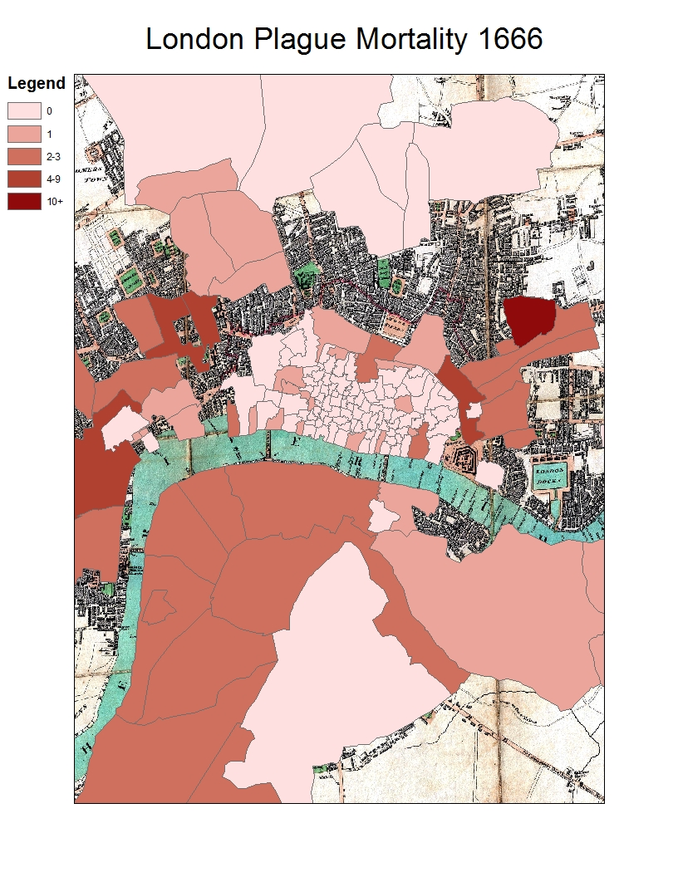

Slide 4
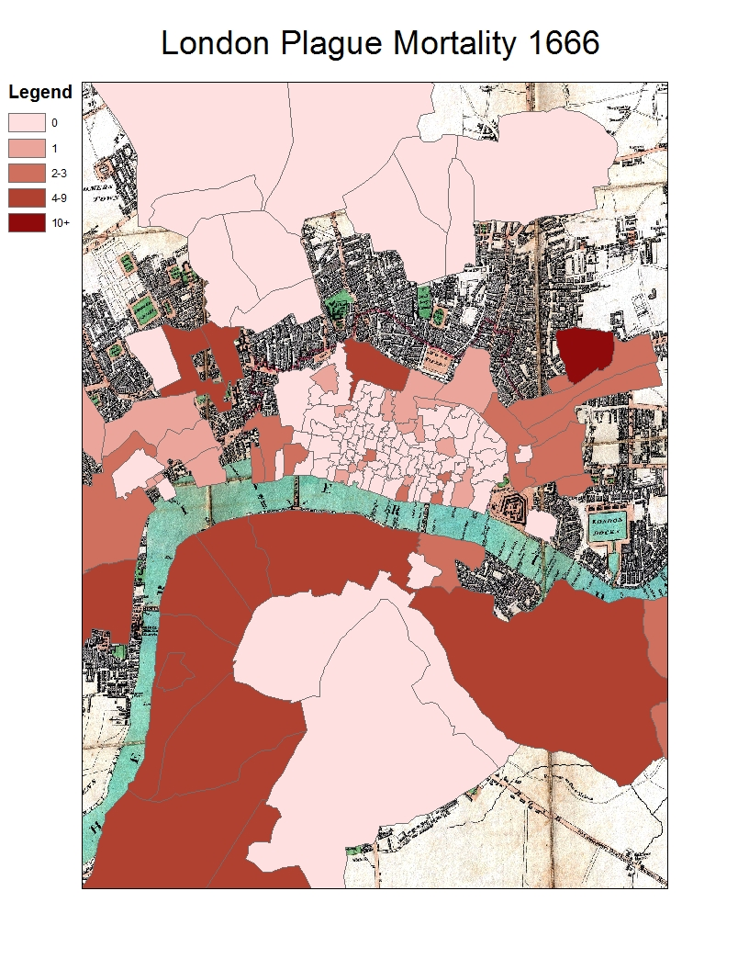

Slide 5
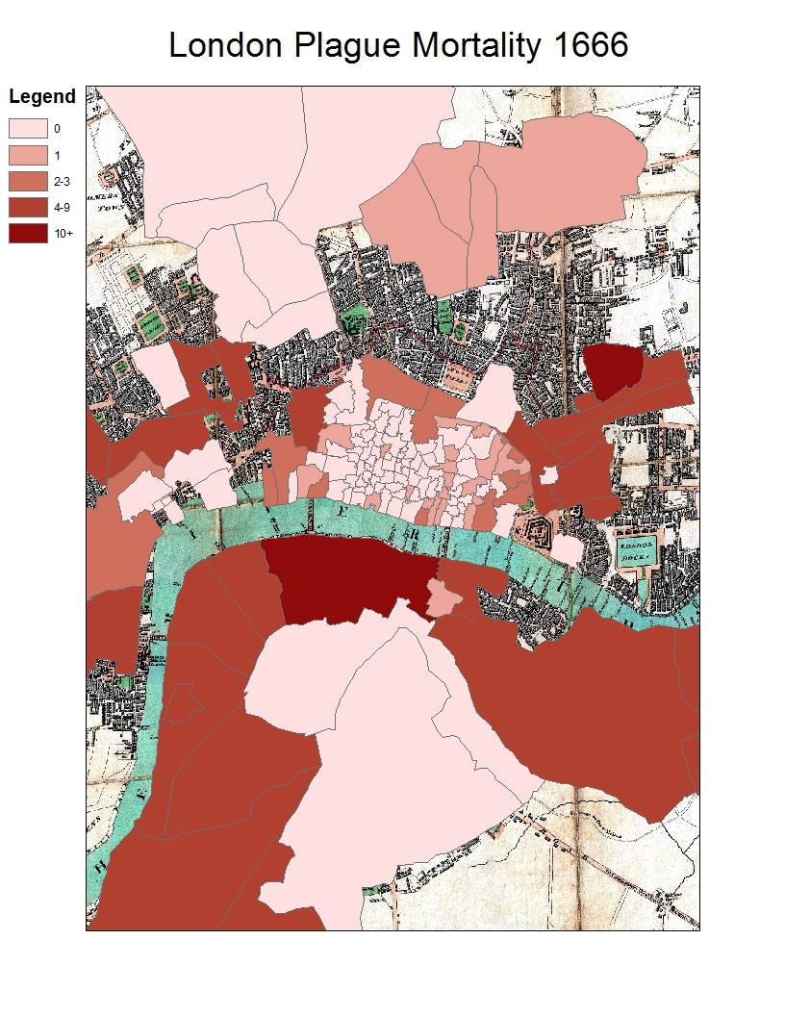

Slide 6
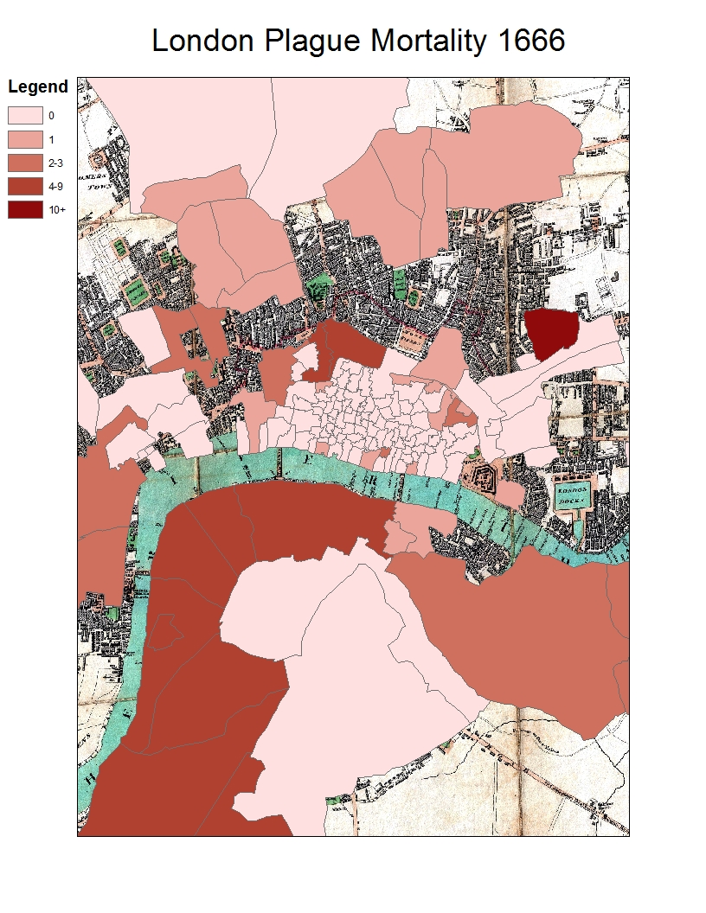

Slide 7
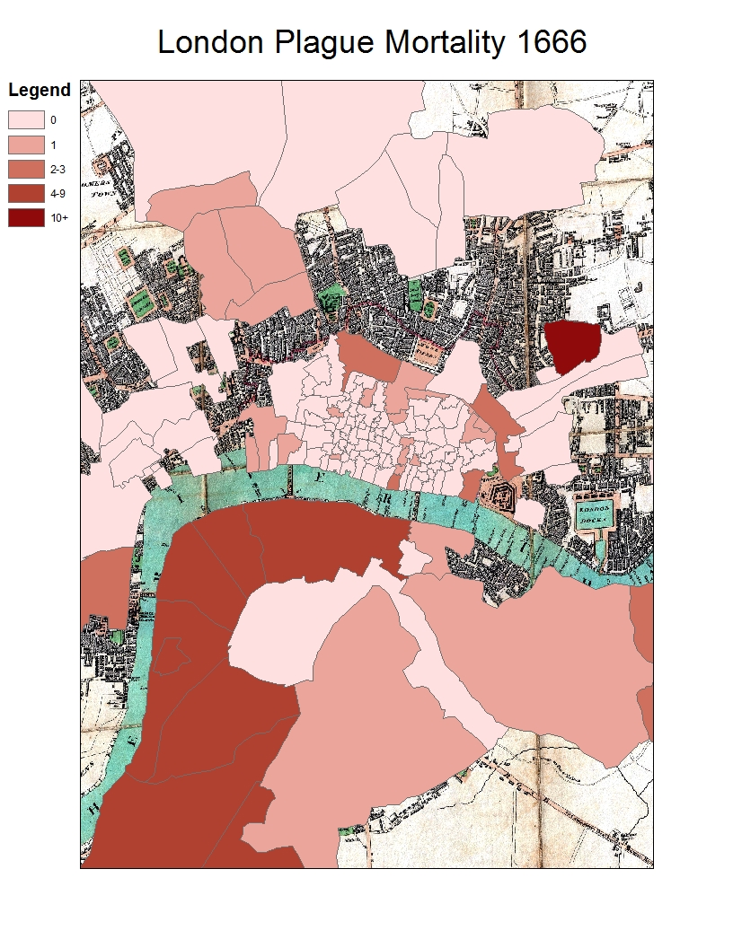

Slide 8
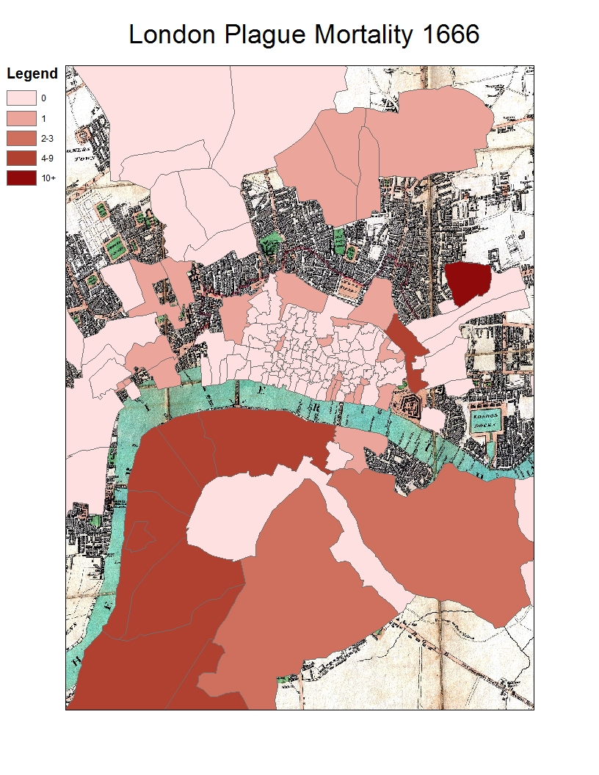

Slide 9
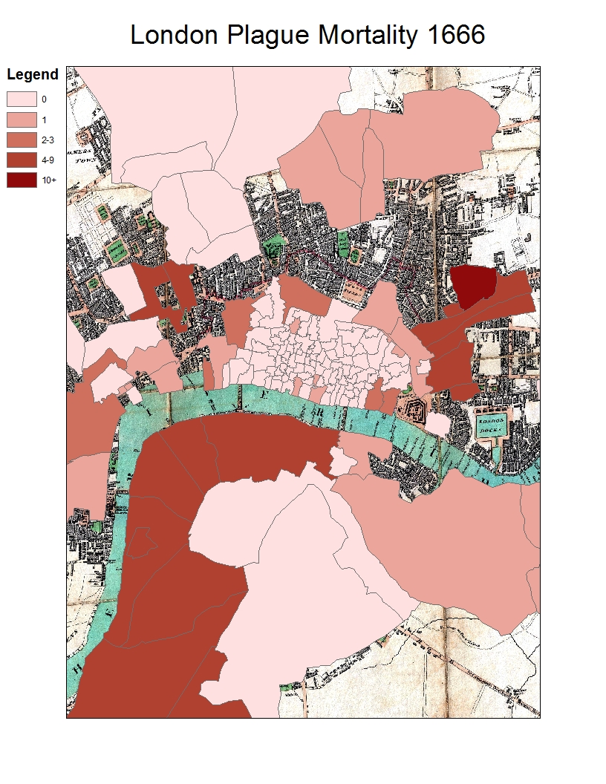

Slide 10
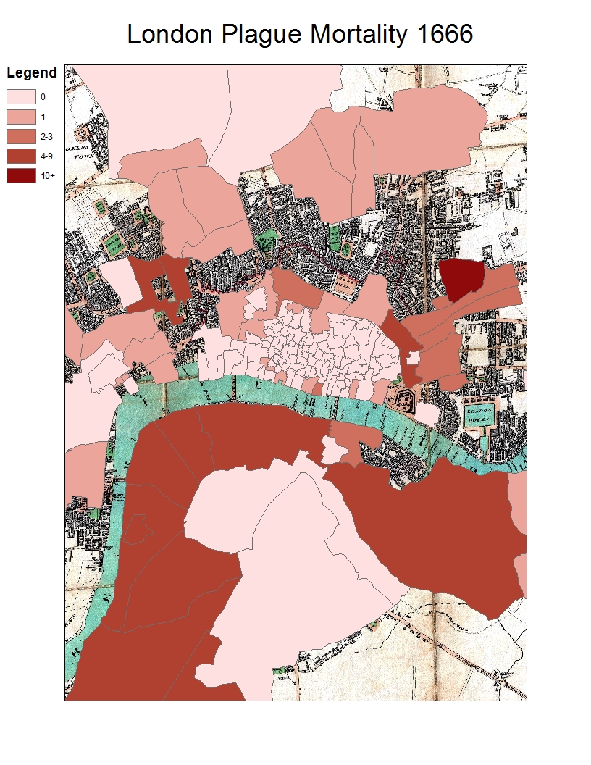

Slide 11
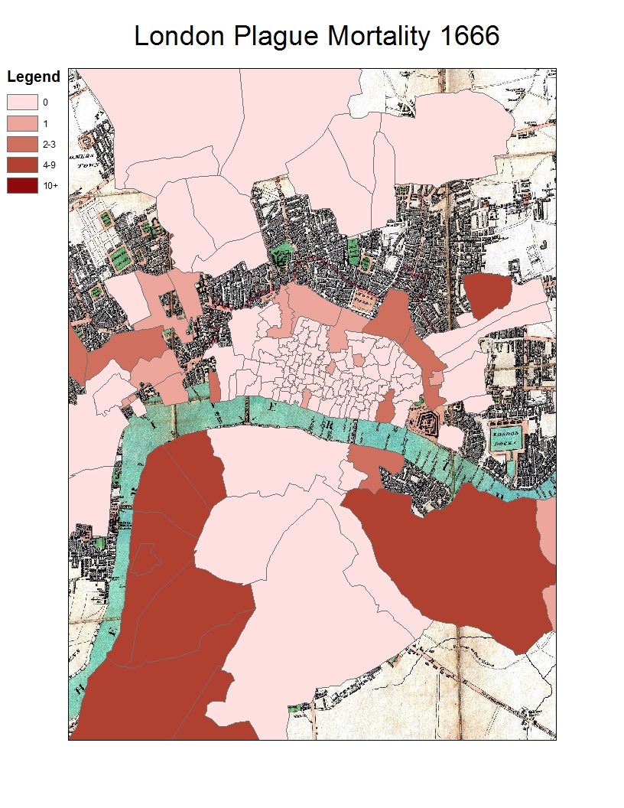

Slide 12
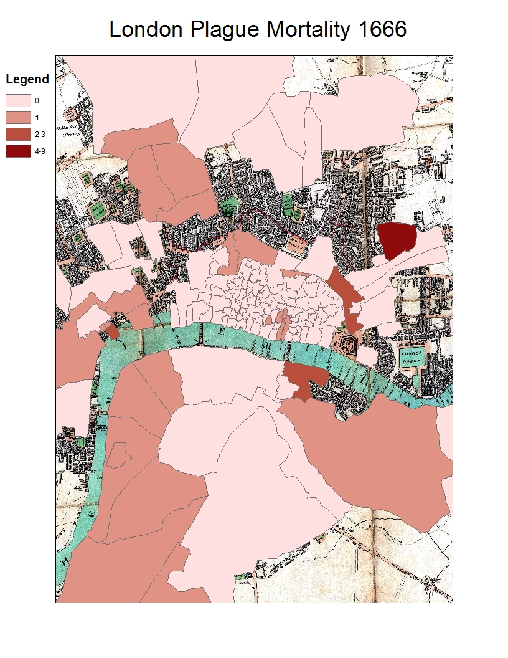

Slide 13
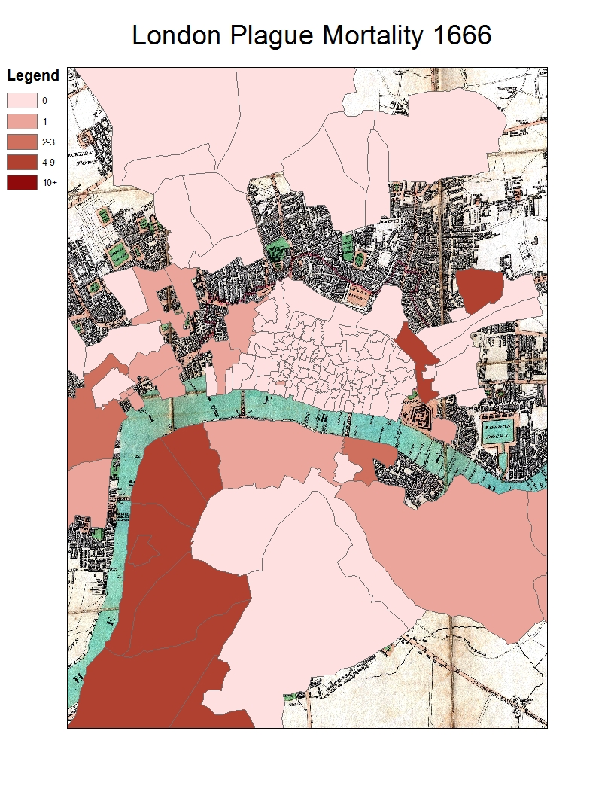

Slide 15
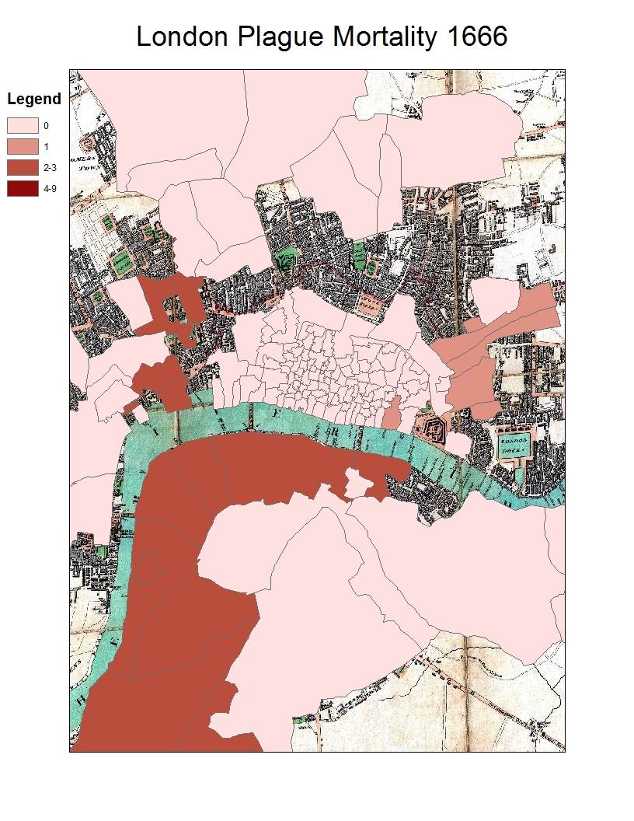

Slide 16
“[T]hen to church, it being thanksgiving-day for the cessation of the plague; but, Lord! How the towne do say that it is hastened before the plague is quite over, there dying some people still.”
-- Samuel Pepys

